Slide 1
Projectile Motion Part 2 Angular Projection

Slide 2
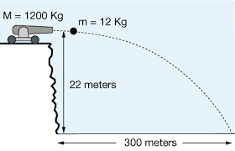
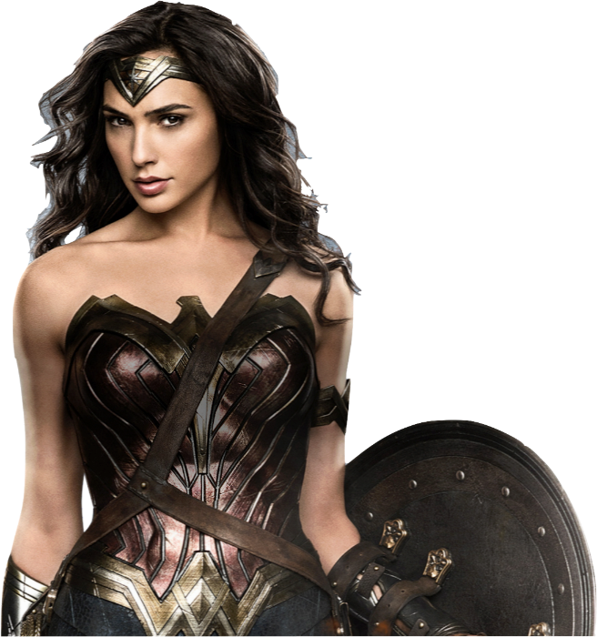
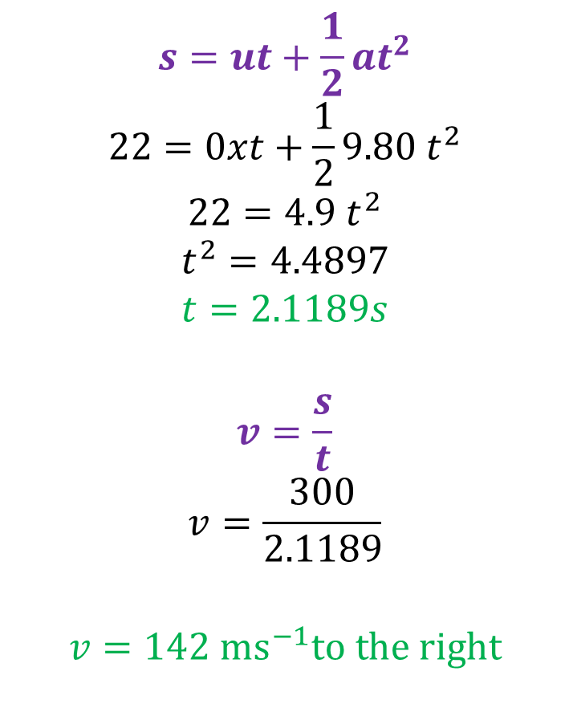
Horizontal Review Question
$$s=ut+\frac{1}{2}at^{2}$$
$$22=0xt+\frac{1}{2}9.80 t^{2}$$
$$22=4.9 t^{2}$$
$$t^{2}=4.4897$$
$$t=2.1189s$$
$$v=\frac{s}{t}$$
$$v=\frac{300}{2.1189}$$
$$v=142 {ms}^{−1}to the right$$
STEP 1
Calculate the time in the air from vertical components of motion.
How fast is the cannon ball fired from the cannon?
STEP 2
Calculate horizontal velocity from time and horizontal displacement.

Slide 3

If vertical motion is independent of horizontal motion,
what happens if the cannon fires something at an angle?

Slide 4

I don’t know …
We might need to kill Bieber again to find out?

Slide 5

Starting with vertical motion
If we fire Justin Bieber from a cannon angled at 30 degrees at 25m.s^{-1,} how far away will his body land?
What is his maximum height?
What do you mean?

Slide 6

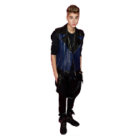
Starting with vertical motion
Baby … Baby .. Baby …
25 m.s⁻¹
30°

Slide 7
Starting with vertical motion
Split the initial velocity into vertical and horizontal components
Which component of motion is most important in determining “air time”?
25 m.s⁻¹
v_{v} = 25sin30°
30°
v_{h} = 25cos30°

Slide 8
Starting with vertical motion
2. Looking at the vertical motion, when the Bieber hits the floor, his VERTICAL displacement will be = 0 zero again. We don’t need to think about how far he moved up and down, because displacement is a vector.
Using DOWN as positive
u_{v} = - 25sin30° (-ve because it is up)
a = 9.8 m.s⁻²
25 m.s⁻¹
30°

Slide 9
Starting with vertical motion
3. Using s = ut + ½at²
0 = - 25sin30°t + ½(9.8)t²
0 = -12.5t + 4.9t²
4.9t² = 12.5t
4.9t = 12.5
t = 12.5/4.9
t = 2.551 s
25 m.s⁻¹
30°

Slide 10
Starting with vertical motion
4. Looking at horizontal motion
Bieber is in flight for t = 2.55 s travelling with constant horizontal speed of v_{h} = 25cos30° = 21.7 m.s⁻¹.
s_{h}= v_{h}t = 21.7x2.55= 55.4m
Is it too late to say Sorry?…
30°
55.4m

Slide 11
Starting with vertical motion
5. What if we fired Bieber at an angle of 60 degrees?
Will the range be greater or less than 55.4m?
If you calculate where I land accurately… you could save me!
(Or NOT?)
60°
55.4m

Slide 12
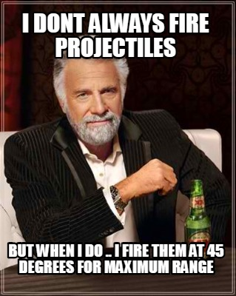
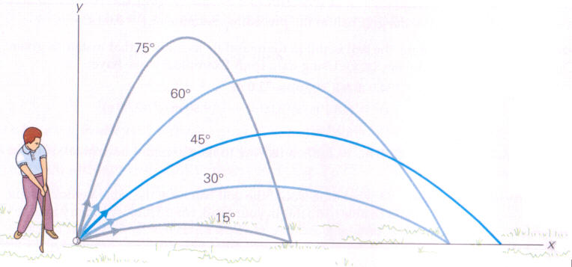
Maximum Range

Slide 13
Starting with vertical motion
6. What about his maximum height?
Some basic facts about motion help us here.
FIRST, the time to go up, is exactly the same as the time to fall back down the same height.
Thus the time to go up, must be half total air time.
We also know that the vertical component of velocity at the highest point is ZERO.
30°

Slide 14

Starting with vertical motion
6. What about his maximum height?
$s=ut+\frac{1}{2}at^{2}$
$s=− 25sin30 x 1.2755+\frac{1}{2}9.8 x {1.2755}^{2}$
$$s=− 7.97m (−ve means it is up)$$
v = 0,
u = - 25sin30°,
t = 2.551/2
=1.2755 s
Max height
s = 7.97m up
30°

Slide 15
Starting with vertical motion
7. Don’t forget some problems can also be answered using energy.
30°

Slide 16
Starting with vertical motion
7. Don’t forget some problems can also be answered using energy.
As Bieber is fired total mechanical energy = ½m(25)²
25 m.s⁻¹
30°

Slide 17
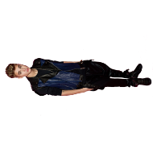
Starting with vertical motion
7. At the highest point,
total energy = KE + GPE =½m(25cos30°)² + mgh
As Bieber is fired total energy = ½m(25)²
30°

Slide 18
Starting with vertical motion
6. So ½m(25cos30°)² + mgh = ½m(25)²
½(21.65)² + 9.8h = ½(25)²
234.4 + 9.8h = 312.5
9.8h = 78.1
h = 7.97 m
30°

Slide 19
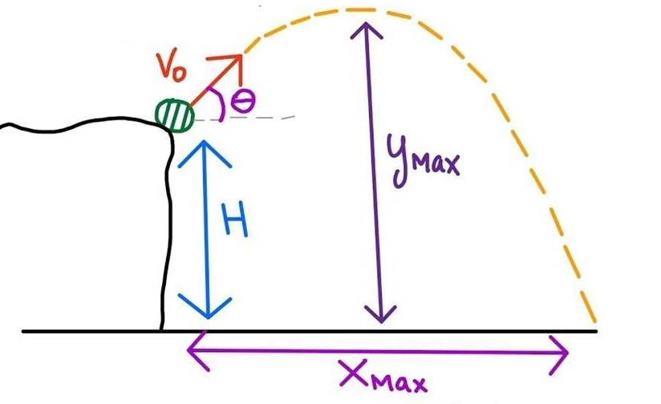
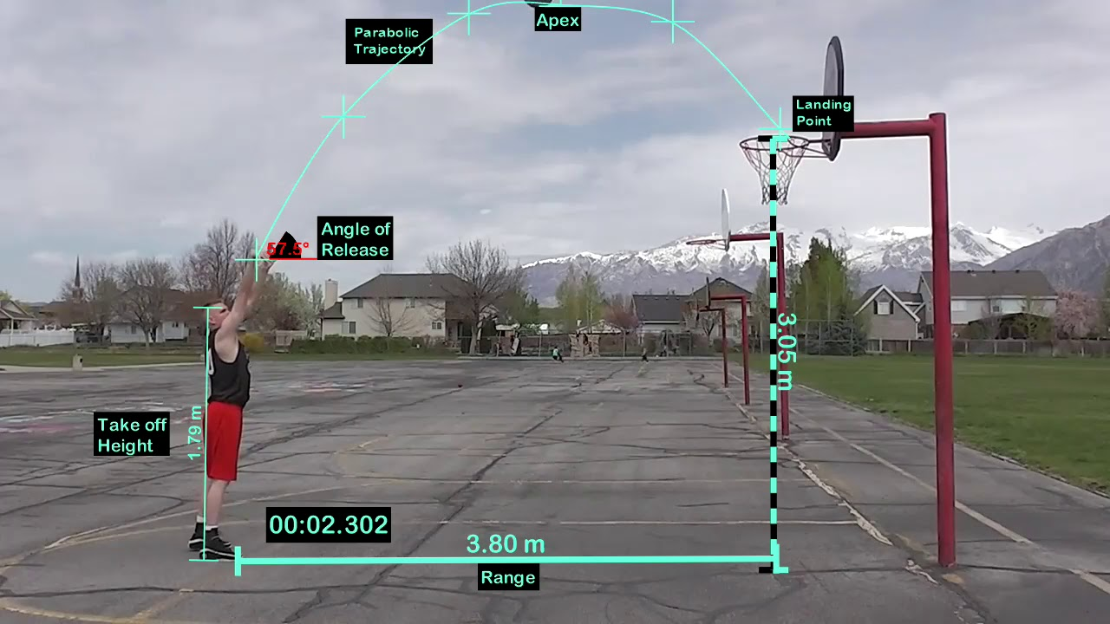
More Challenging Projectile Motion Questions

Slide 20

Now go do your text questions before he decides to kill Kanye again!

